Slide 1
AQA
A Level
Computer Science
Paper 1
Stacks
Unit 7
Data structures

Slide 2
Objectives
Be familiar with the concept and uses of a stack
Be able to describe the creation and maintenance of data within a stack
Be able to describe and apply the following operations: push, pop, peek (or top), test for empty stack, test for full stack
Be able to explain how a stack frame is used with subroutine calls to store return addresses, parameters and local variables

Slide 3
Abstraction
Two abstract data types (ADTs) covered so far are a queue and a list
How are the concepts of data hiding and encapsulation used in the implementation of an abstract data type?

Slide 4

Stack definition
Think of a stack of textbooks
The teacher adds to the top of the stack
The students removes from the top of the stack
Last In First Out = LIFO

Slide 5
Using a stack
Many examples of stacks occur in everyday life – can you think of examples?
Can you think of any examples related to computing?
What operations are needed to implement a stack?

Slide 6
Modelling a stack
The basic operations needed are:
Add an item to the top
Remove an item from the top
Check if the stack is full
Check if the stack is empty

Slide 7
Programming operations
These methods could be written to implement the required functionality of a stack
push(item) – adds item to the top of the stack
pop() – removes and returns the item on the top of the stack
isFull() – checks if the stack is full
isEmpty() – checks if the stack is empty
You might also want to write methods to:
peek() – return the top item without removing it
size() – return the number of items on the stack

Slide 8
Using a stack ADT
In computing, a stack is an important data structure; one reason is that the order of insertion is the reverse of the order of removal
Suppose you pop the letters r, o, b, e, r, t from a list letters, pushing each one onto a stack s
Now remove all these letters from the stack, adding each letter back into the list – what does the list look like now?

Slide 9
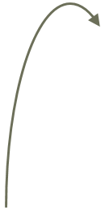
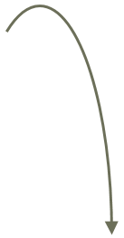
Algorithm for reversing a list
letters ← [“r”, “o”, “b”, “e”, “r”, “t”]
FOR each letter in letters
remove letter from front of list
push letter onto s
ENDFOR
FOR each letter in s
pop letter from stack
append letter to letters
ENDFOR
t
r
e
b
o
r
[r, o, b, e, r, t]
[t, r, e, b, o, r]

Slide 10
Implementing a stack as a list
It’s very easy to implement a stack as a list
What list methods could you use to implement these functions?
Add an item to a stack
Remove an item from a stack
Check if the stack is empty
Find the number of items in the stack

Slide 11
Using a list
Using built-in list operations, you could use the following list methods:
append(item) – add item to the top of the stack
pop() – remove and returns the item on the top of the stack
len(stack) – find the length (height) of the stack

Slide 12
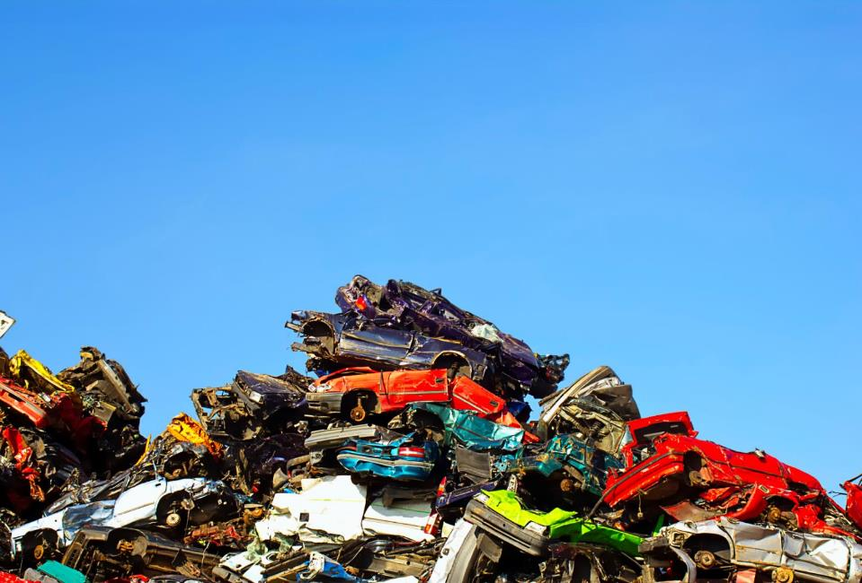
Worksheet 3
Complete Task 1 of the worksheet

Slide 13
Overflow and underflow
Overflow – attempting to push onto a stack that is full
Underflow – attempting to pop from a stack that is empty
Note that if a stack is implemented using a dynamic list structure, there may be no “stack full” test. The computer may simply give a “stack overflow” error when it runs out of memory

Slide 14
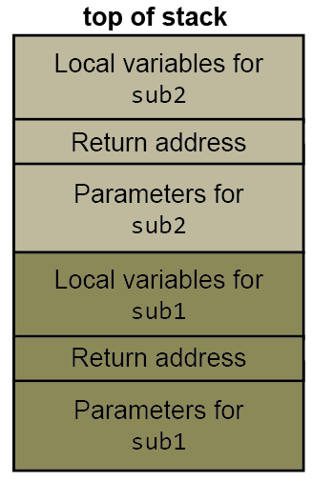
The call stack
The call stack is a system level data structure
It provides the mechanism for passing parameters and return addresses to subroutines
In high-level programming languages the use of the call stack is hidden from the programmer

Slide 15
Call stack
What happens when this code is executed?
bigger ← max (num1, num2)
The programmer doesn’t need to know how the arguments (num1, num2) are sent to the function max, or how the result is returned to the calling program
The values of num1 and num2 and the return address (the line after the call statement), are saved on the stack
These values are popped when the function completes

Slide 16
Subroutine calls
Calls to subroutines are executed as follows:
The parameters are saved onto the stack
Local variables are saved onto the stack
The address to which execution returns after the end of the subroutine is reached is saved onto the stack
Execution is transferred to the subroutine code

Slide 17
Subroutine execution
Subroutines are executed as follows:
Stack space is allocated for local variables
The subroutine code executes
The return address is retrieved
The parameters are popped
Execution is transferred back to the return address

Slide 18
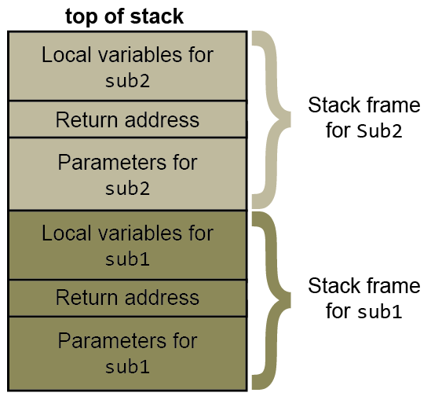
Stack frame
A stack frame contains all the parameters, the return address and the local variables for a single call to a subroutine which has not yet completed

Slide 19
Local variables
Local variables are allocated space on the stack
Describe what happens when line 148 is executed
143 | main ()
144 | num1 ← 12
145 | num2 ← 7
146 | print (num1)
147 | print (num2)
148 | bigger ← findMax(num1, num2)
149 | print (bigger)
78 | SUB findMax(p1, p2)
79 | max ← 0
80 | IF (p1 > p2) THEN
81 | max ← p1
82 | ELSE
83 | max ← p2
84 | ENDIF
85 | RETURN max
86 | ENDSUB

Slide 20
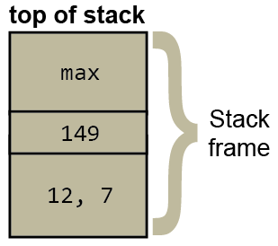
The call stack
Parameters 12 and 7 (num1, num2) are pushed on to the stack
Return address 149 is pushed onto stack and control is transferred to subroutine
Local variable max is pushed onto stack
max is updated at line 81 in subroutine
When subroutine completes, max is popped and assigned to bigger
Return address 149 is popped and held
Values 12, 7 are popped
Execution resumes at line 149

Slide 21
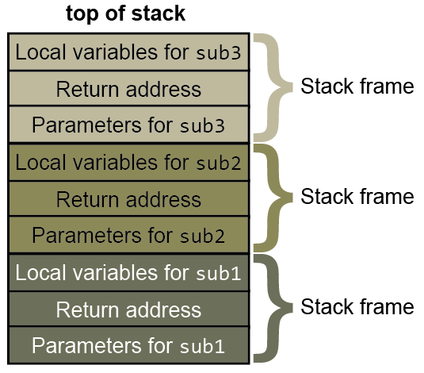
Nested subroutines
What happens when subroutine calls are nested? E.g. sub1 calls sub2, which calls sub3

Slide 22
Worksheet
Complete the ‘Subroutine Snake’ task on Worksheet 3

Slide 23
Plenary
Describe a stack
Describe the operations on a stack
Describe the system call stack
What goes into a stack frame?
Compare the behaviour of a stack with the behaviour of a queue

